Slide 1
Airline
Passenger
Satisfaction
Let’s know more about customer satisfaction

Slide 2
Team 6
1
Asmaa Adel
2
Samaa Hazem
3
Norhan Reda
4
Hoda Gamal
Supervisor: Eng. Omar Samir

Slide 3
Table of contents
1
Motivation
2
Data Preprocessing
3
EDA
4
Models used
5
Cloud part
6
business Part

Slide 4
1
Motivation
Why we are motivated to work on this problem

Slide 5
Why we are motivated to work on this problem ?
Airline companies strive to provide the best possible travel experience for their passengers to maintain customer satisfaction and loyalty
Understanding the factors that contribute to passenger satisfaction is crucial for airlines to improve their services, enhance customer experience, and stay competitive in the industry
By accurately predicting passenger satisfaction, airlines can identify areas for improvement and tailor their services to meet customer expectations more effectively
Additionally, satisfied passengers are more likely to become repeat customers and recommend the airline to others, leading to increased revenue and growth
The problem can be framed as a binary classification task, where the goal is to predict whether a passenger is satisfied or dissatisfied based on the input features.

Slide 6
Data Preprocessing
2
Here We tell how we handle the dataset

Slide 7
Preprocessing
Drop Nulls
Encode nominal features
Normalize the numerical features
Convert to one Hot in Naive bayes

Slide 8
EDA
3
Here we start by visualizing the data

Slide 9
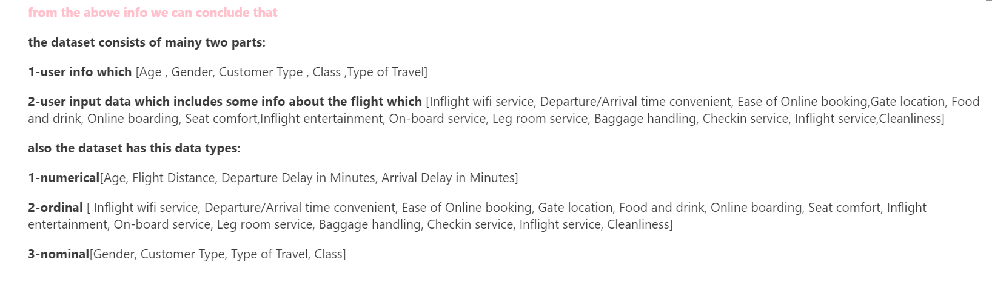
Explore the dataset
Dataset is divided to 2 parts:
Train dataset: 103904 rows, Test dataset: 25976 rows, Each with 25 column
Dataset Columns:
Target column:
Satisfaction (satisfied/ neutral or dissatisfied)

Slide 10
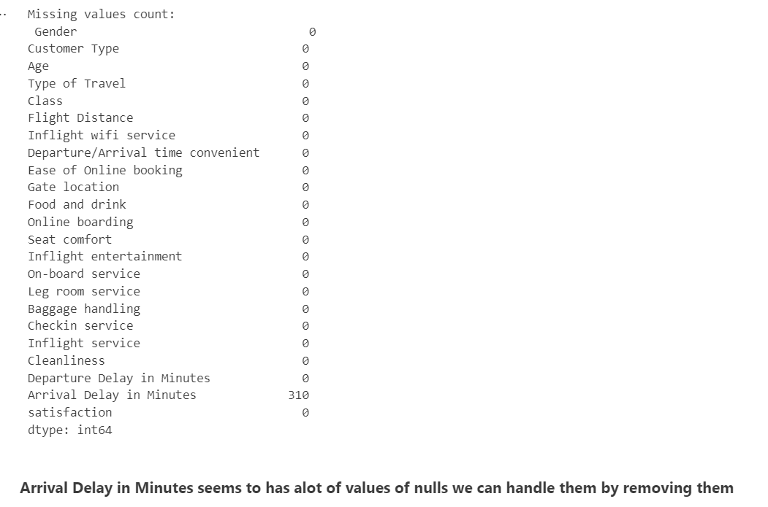
Missing Values

Slide 11
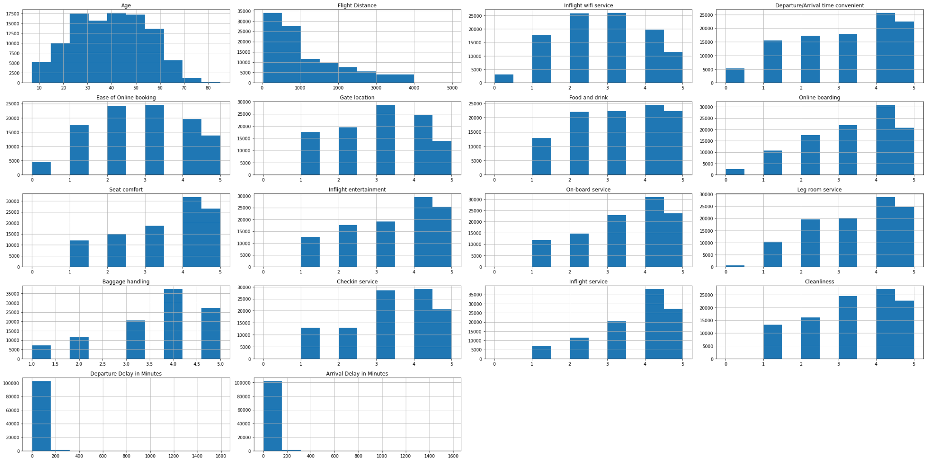
Visualization: Histograms

Slide 12
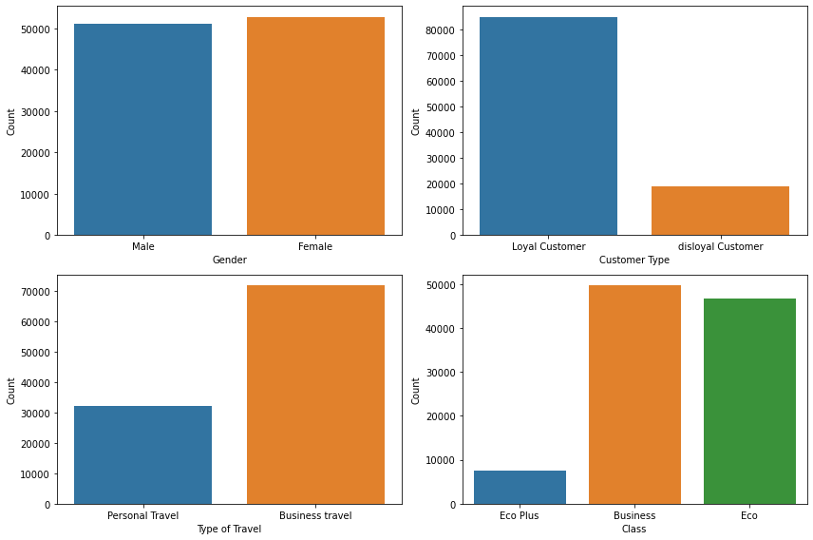
Visualization: Count plots

Slide 13
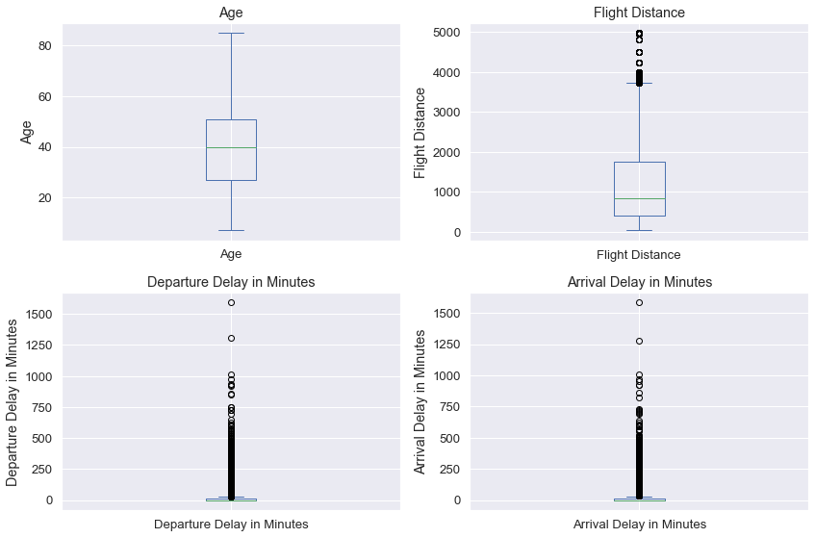
Visualization: Box plots (Identifying outliers)

Slide 14
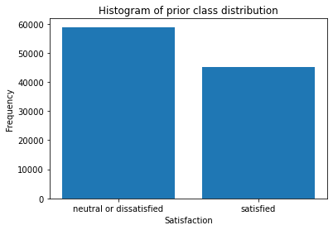
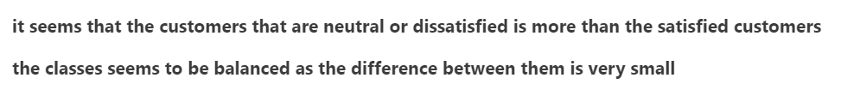
Visualization: Prior class distribution

Slide 15
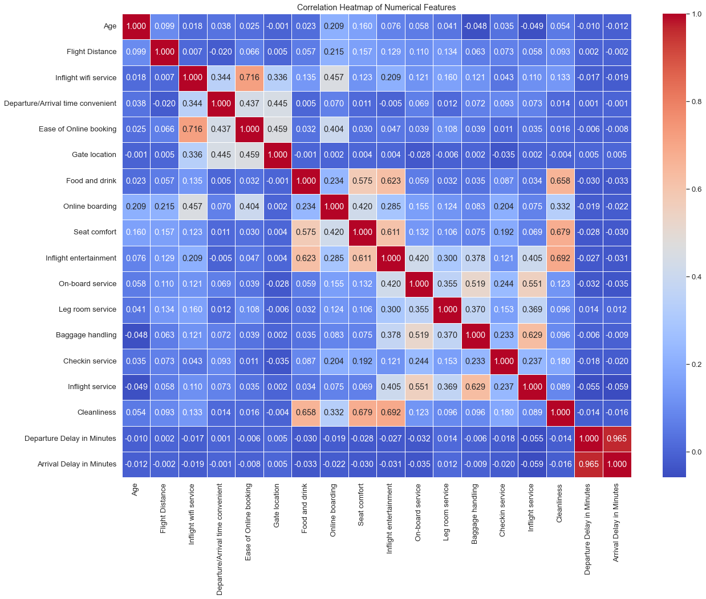
Visualization: Correlation

Slide 16
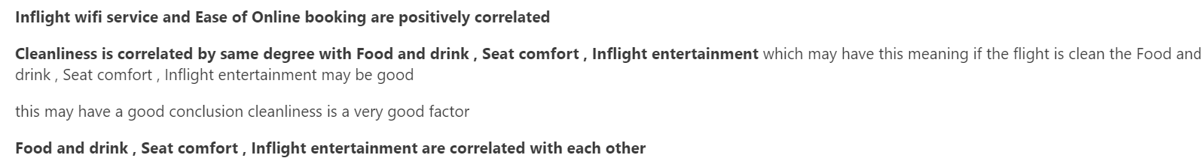
Visualization: Correlation

Slide 17
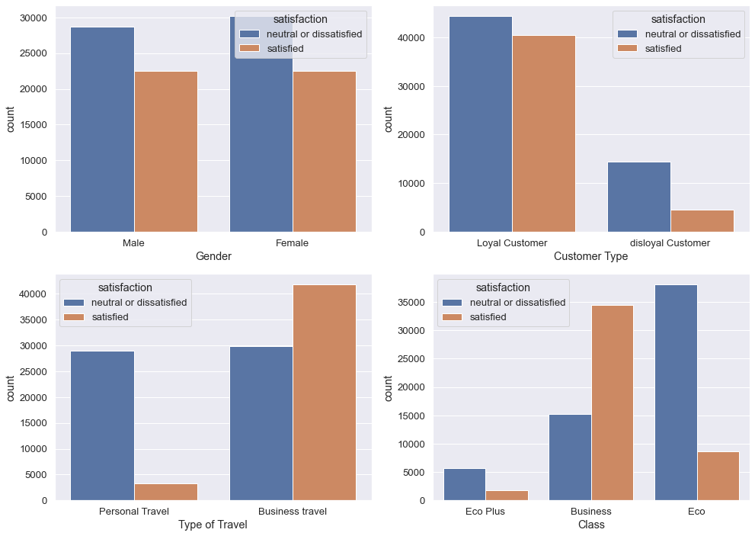
Visualization: Features with satisfaction

Slide 18
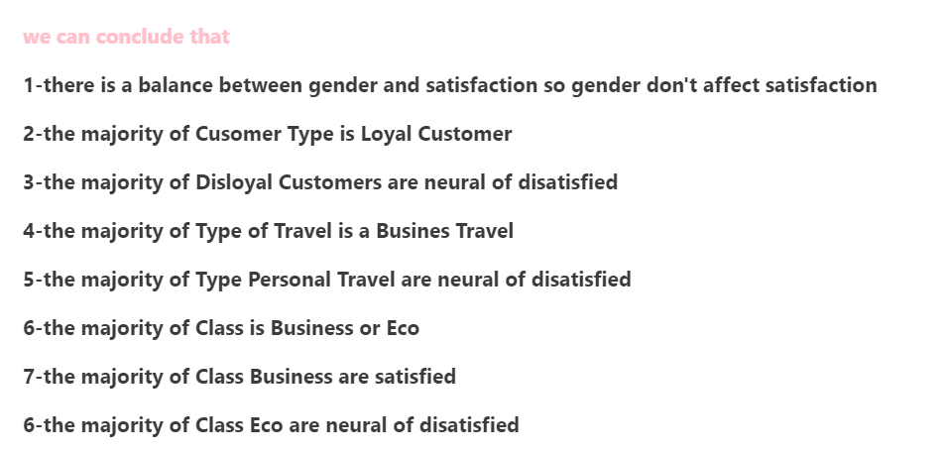
Visualization: Features with satisfaction

Slide 19
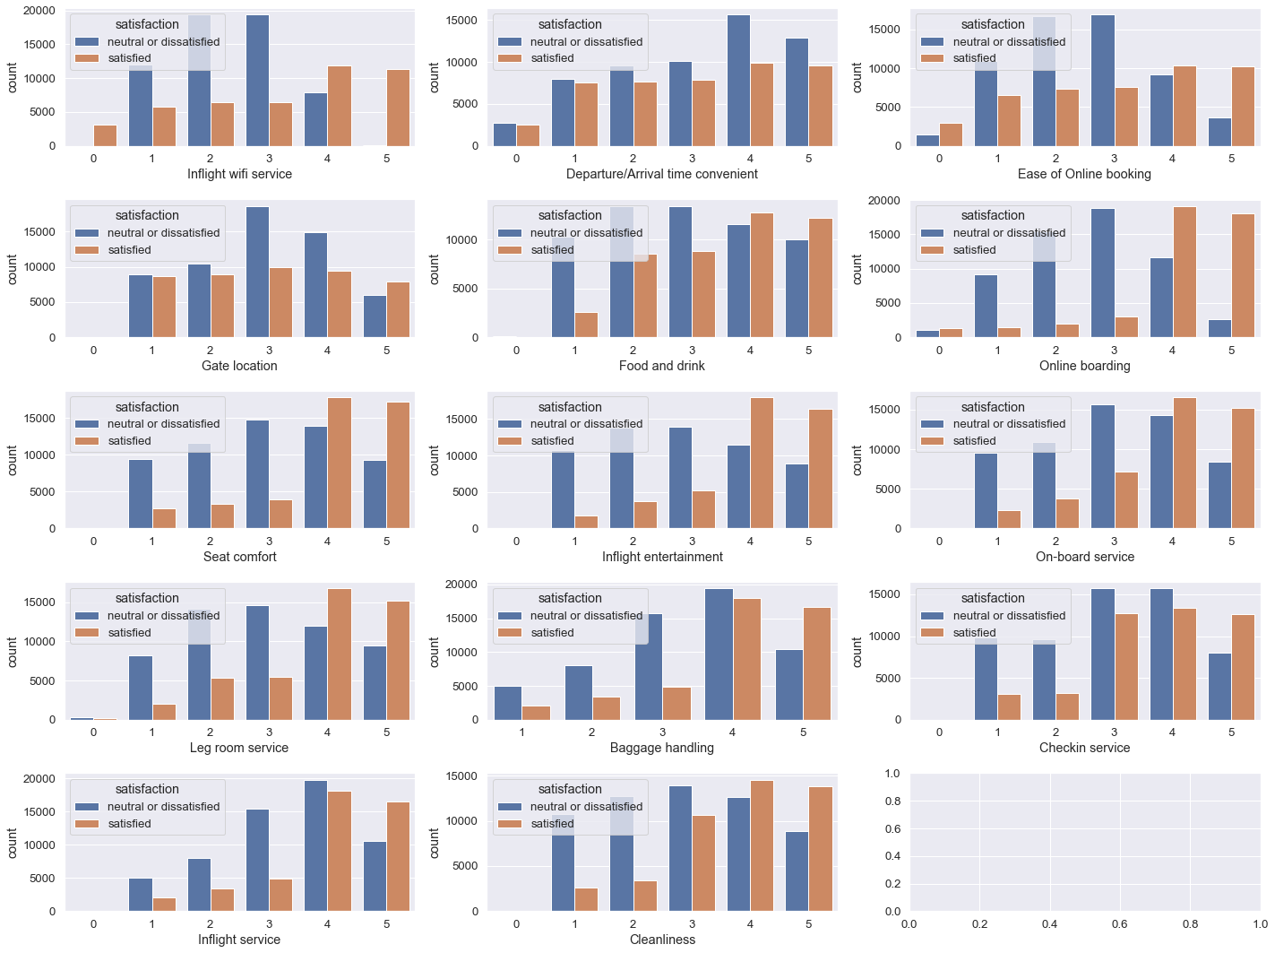
Visualization: Features with satisfaction

Slide 20
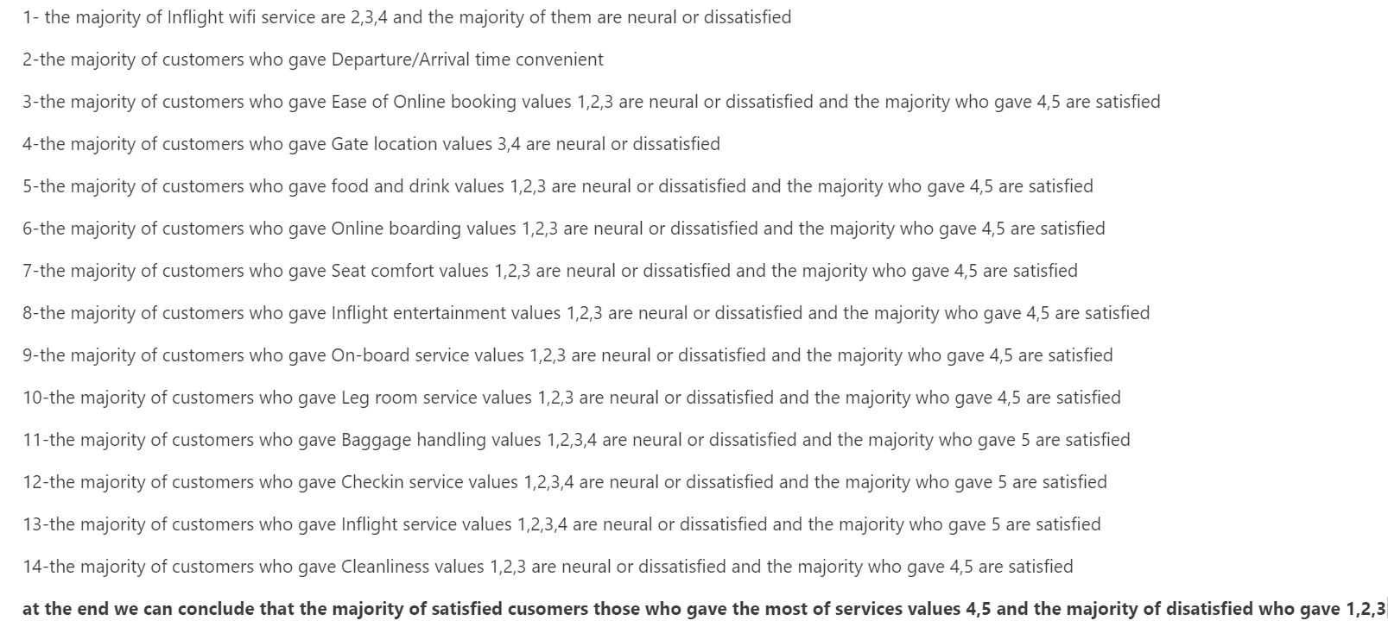
Visualization: Features with satisfaction

Slide 21
Models used
4
The pipeline of models used for this problem

Slide 22
Models used
Random Forest
SVM
KNN
Naive Bayes
Aprori
K Means cluster
pyspark mapreduce
sklearn
sklearn
-our mapreduce
-pyspark mapreduce
-sklearn
mlxtend
sklearn

Slide 23
Classification Models Accuracy
Model | Train set accuracy | Test set accuracy
Random Forest (pyspark mapreduce) | 99.98% | 96.34%
SVM | 94.60% | 94.58%
KNN (sklearn) | 94.58% | 93.14%
Naive Bayes (our mapreduce) | 89.35% | 89%
Naive Bayes (pyspark mapreduce) | 89.35% | 89%
Naive Bayes (sklearn) | 89.35% | 89%

Slide 24
Random Forest
Random Forest From pyspark:
numTrees=80,maxDepth=30
We have tried many values of them but those gives us the max accuracy.

Slide 25
SVM
Here we used the default SVM model of sklearn.

Slide 26
KNN
Here we used KNN with k=7 from sklearn

Slide 27
Naive Bayes
Naive Bayes (Multinomial) implementation using MapReduce:
It consists of 3 stages, each stage consists of mapper and reducer.
Stage 1 for calculating the prior probabilities:
Map:
Input: row of data
Output: key value pair of (class label, 1)
Reduce:
Input: key value pair of (class label, list of 1s)
Output: key value pair of (class label, sum of the list as the count of this class )
prior probability = log(count/total_size)

Slide 28
Naive Bayes
Naive Bayes (Multinomial) implementation using MapReduce:
Stage 2 for calculating the likelihood probabilities:
Map:
Input: row of data
Output: key value pair of (class label, (feature, feature value, count)
Reduce:
Input: key value pair of (class label, list of tuples (feature, feature value, count) )
Output: key value pair of (class label, feature, feature value, probability)
Probability = log(count / total count of the class)

Slide 29
Naive Bayes
Naive Bayes (Multinomial) implementation using MapReduce:
Stage 3 for calculating the accuracy:
Map:
Input: row of data
Output: key value pair of (0,0) if predicted class is wrong
or (0,1) if predicted class is correct
Reduce:
Input: key value pair of (0, list of 0s and 1s)
Output: key value pair of (0, sum of this list as number of correct predictions)
Accuracy = number of correct predictions / total data size

Slide 30
Naive Bayes
Naive Bayes using pyspark:
With model Type ="multinomial" and smoothing= 0
Naive Bayes using sklearn:
MultinomialNB model
With alpha = 1.0e-10

Slide 31
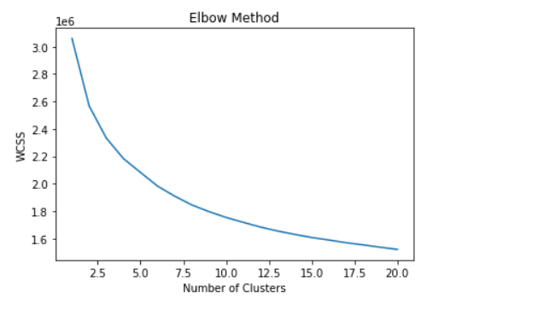
K-means cluster
Here we used the Elbow method to get the optimal number of clusters
From the graph the optimal number of clusters is k =3

Slide 32
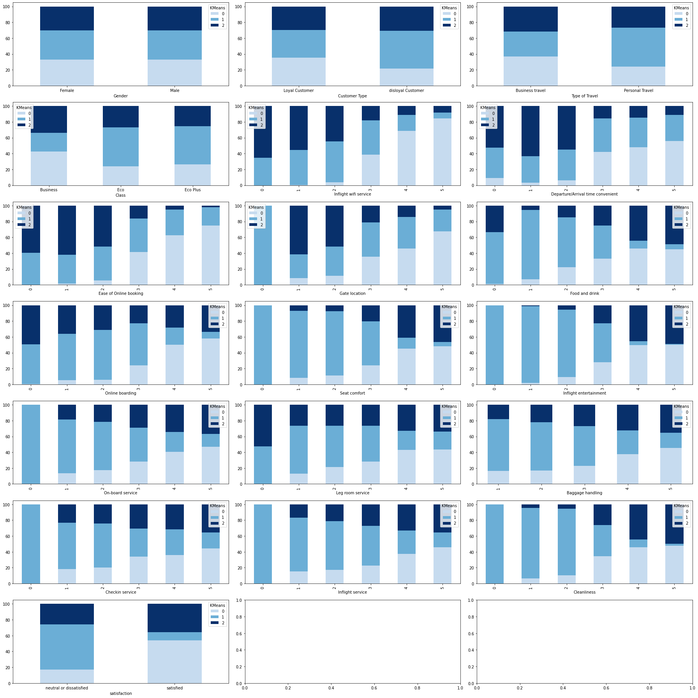
K-means cluster
Grouping all features and label with clusters

Slide 33
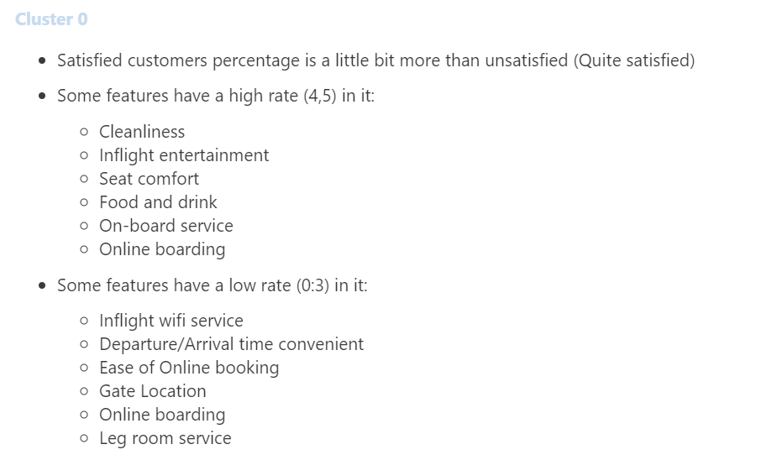
K-means cluster

Slide 34
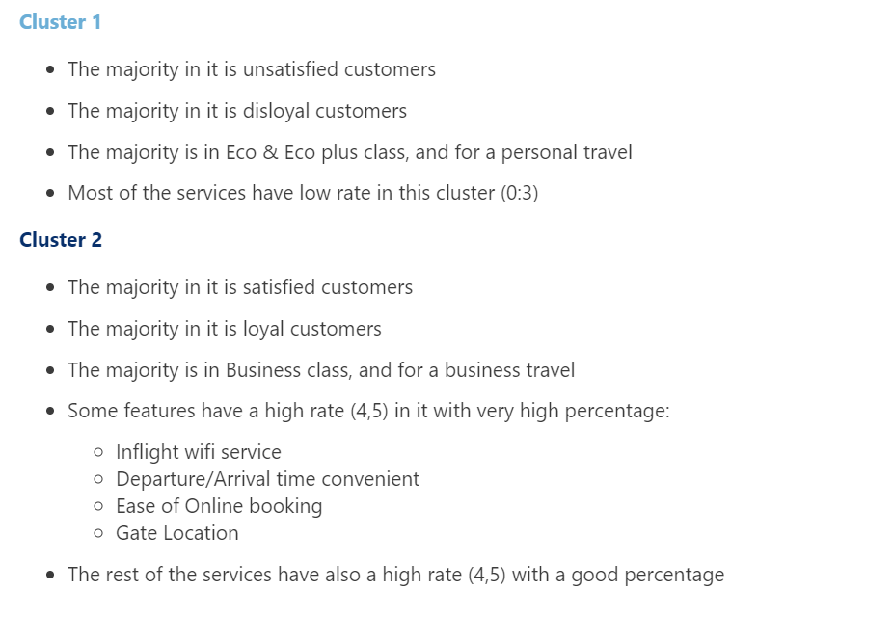
K-means cluster

Slide 35
K-means cluster

Slide 36
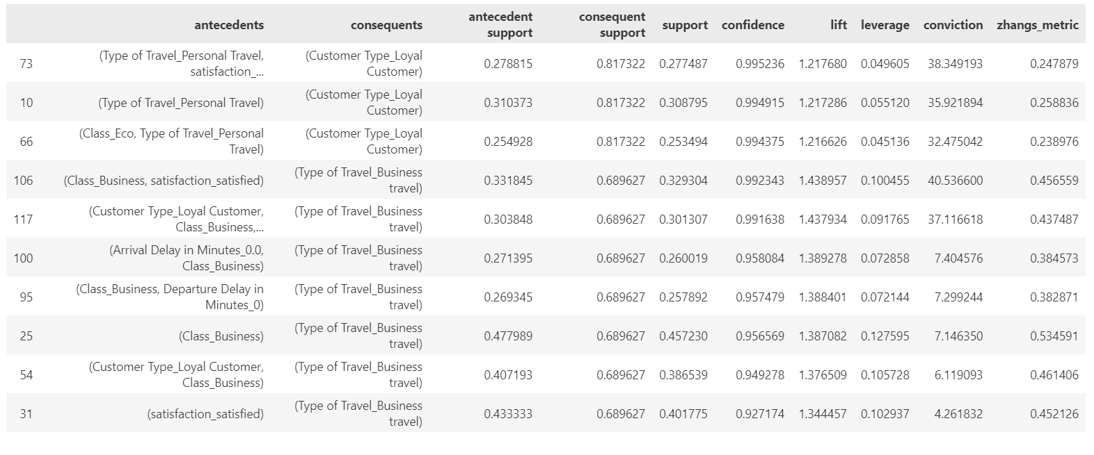
Aprori
Here we get the most frequent items by setting a minimum support of 25%
and then get the rules base on lift of threshold =1
And for the result rules we sort them based on lift and confidence
and that what we got for the most top rules

Slide 37
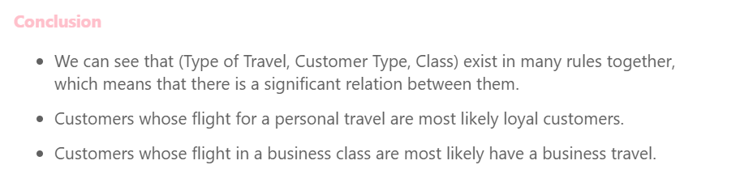
Aprori

Slide 38
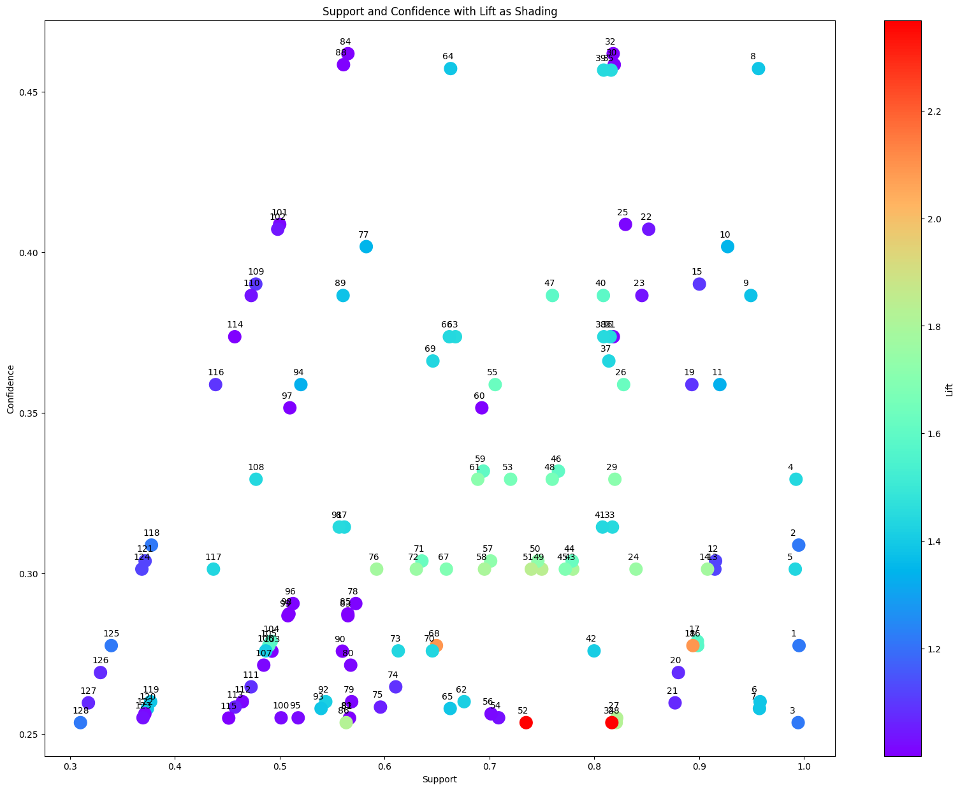
Aprori

Slide 39
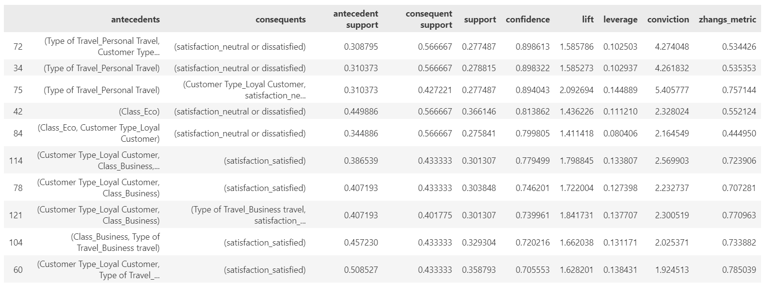
Aprori
And another thing that we do is to get the rules that has the satisfaction label of the consequent to know which rule lead to satisfaction and dissatisfaction.

Slide 40
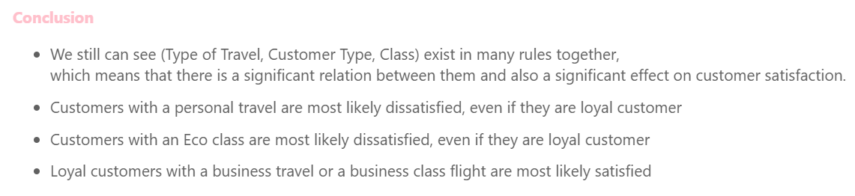
Aprori

Slide 41
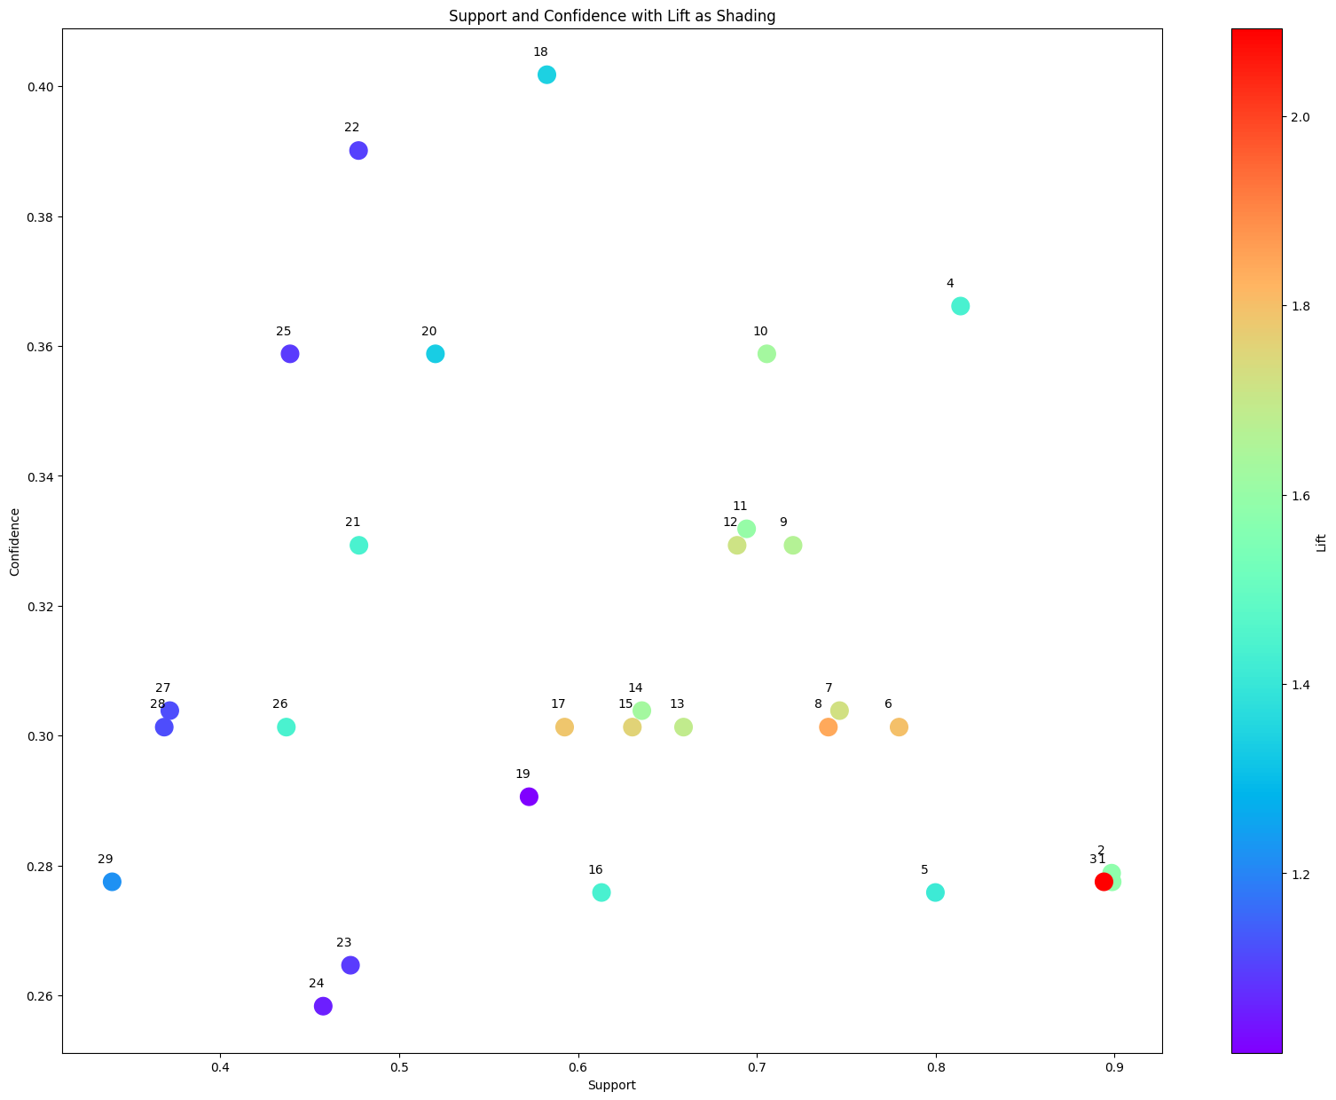
Aprori

Slide 42
Cloud Part
Bouns
5

Slide 43
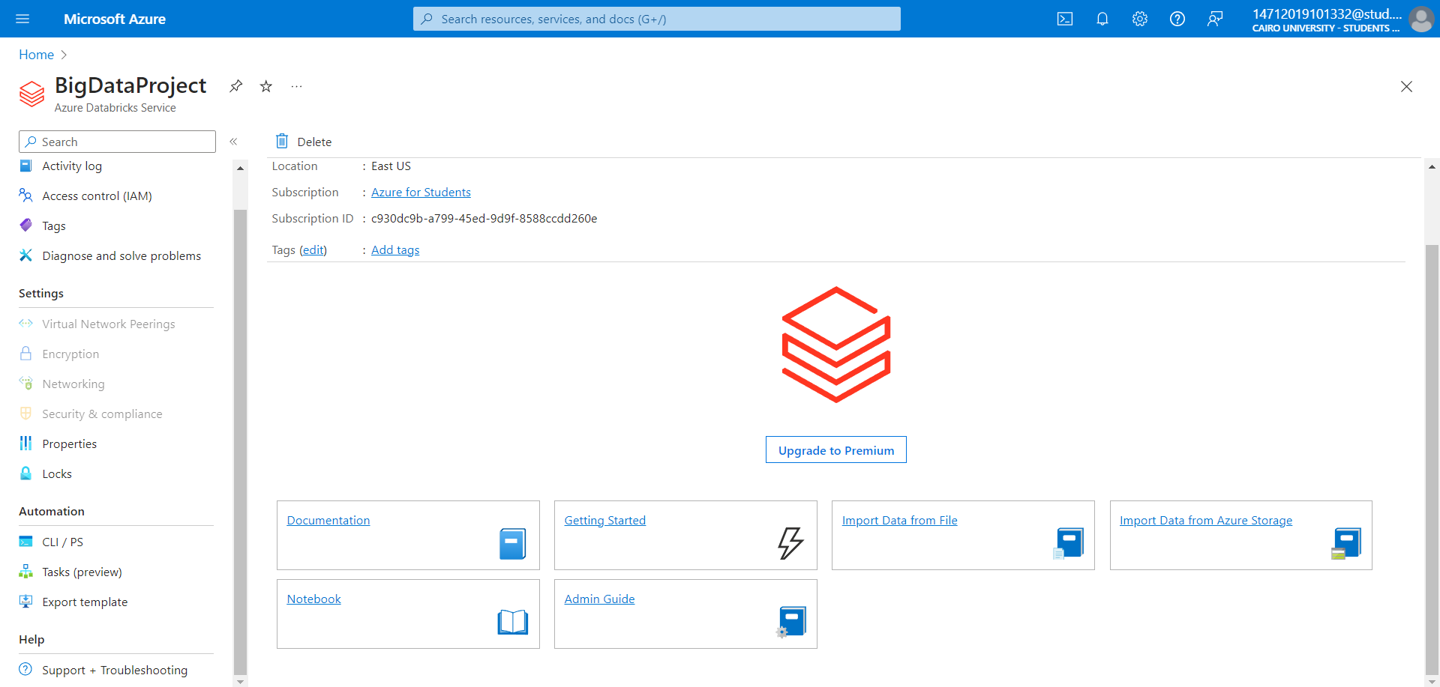
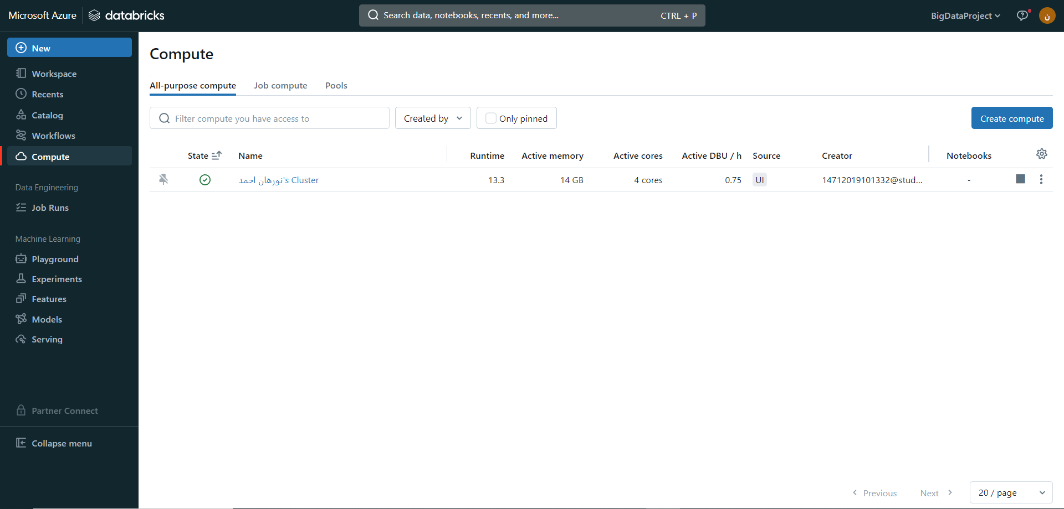
1-We create a databricks workspace
2-Then we create a Compute unit

Slide 44
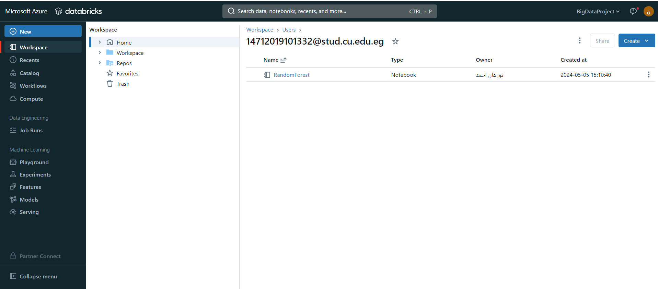
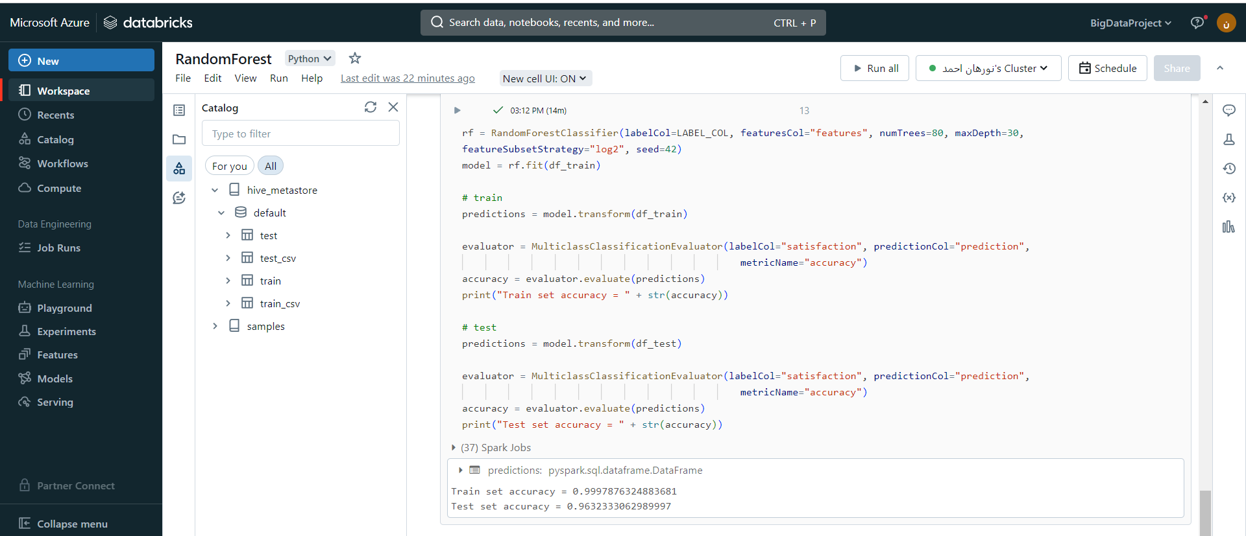
3-Then we upload the model notebooks and dataset
4-run this model

Slide 45
Business Part
6
How the business could benefit from our analysis

Slide 46
Business
There is a significant percentage of dissatisfaction between customers, as more than 50% of customers are neutral or dissatisfied.
Gender of the customer has no effect on the satisfaction.
Loyal customer percentage is more than 80%, so the loyalty of customers doesn’t make them satisfied.
More than 68% of the customers have the flight for business travels.
The majority of flight class is the Business class, and after it Eco class, Eco plus class percentage is very small.
Lack of customer satisfaction on Departure/Arrival time convenient feature, So they should also give this more attention to the Departure/Arrival time.

Slide 47
Business
Most dissatisfied customers are the customers whose flight class is Eco or Eco plus, and their flight for personal purposes.
On the other hand, most satisfied customers are the customers whose flight class is Business, and their flight for business purposes.
So Type of Travel, Flight Class play a significant role in customer satisfaction.
So They should give more attention to Eco class services.
Arrival delay and departure delay are very related to each other positively.
Cleanliness, Food and drink , Seat comfort , Inflight entertainment are related to each other.
Inflight wifi service and Ease of Online booking are related to each other positively.

Slide 48

Thanks!

